Slide 1
Breakfast Club
By: Alexa Saur, Arnav Grover, Alan Portnoy, Gabrielle Jones, Julia Malyszko, and Matthew Miller

Slide 2
The Billion Oyster Project
What is the goal of the BOP?
Restore oyster reefs
208 Active Oyster Restoration Stations
What will the comeback of oysters do for the environment?
Provide habitats for many aquatic species
Filter water
Help shield shorelines from storm damage
How can we help?
Notes:
The BOP (Billion Oyster Project) is a nonprofit organization dedicated to supporting the repopulation of oysters in New York harbor
The comeback of oysters will add diversity to the harbor and allow the oyster reefs to shelter a plethora of species while reducing flooding in NY
We as students are helping by utilizing Python to better understand environmental trends, collecting data to determine the best locations for oysters, and using Data Visualization to convey this information to an audience
What’s better than learning and helping at the same time?

Slide 3
About Oysters
Diet : zooplankton, shrimps, crab, fish
Movement : Sessile Organism
Feeding Habits : “Filter” Feeders (nitrogen and phosphorus)
Threats : MSX, Endermo, acidic water, salinity changes
What are the optimal conditions for an oyster to live?
pH : 6.75 - 8.75
Shell Height : triploid oysters : 83mm ; diploid oysters 76 mm
Salinity : 10 - 25 ppt.
Temp : 68- 90 °F (20 - 32 °C)
Notes:
MSX is protozoan parasite
Endermo is present in Chesapeake Bay
Acidic water means (cannot grow their essential shells), oysters prefer basic water for the minerals
Salinity affects growth rate

Slide 4
Our Process
Brainstorming
Narrowing it Down
Testing
Presenting
Notes:
In out brainstorming phase we came up with many possible questions
We had to take into account the data we were given, so out of the many we chose our main research question
We came up with different models of the data, at first we did a test with the whole data, then we broke it down into specific locations
Finally we visualized the information using charts and graphs

Slide 5
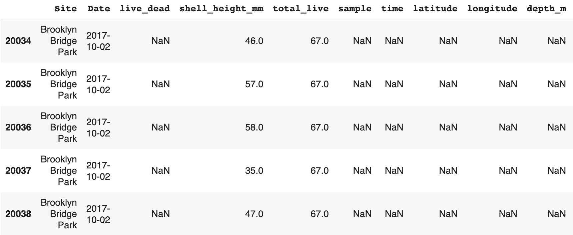
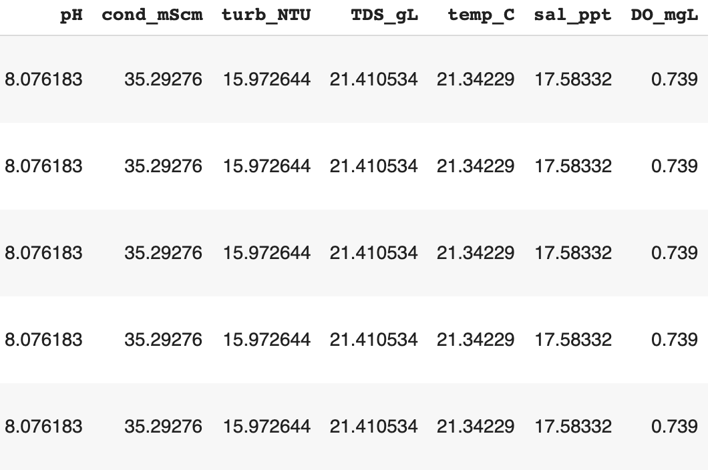
Our Data
Notes:
The data that we received was just over 20,000 rows long
It would have taken us a very long time to do it by hand
This shows how Python was able to significantly help us, we were able to analyze trends within such a big data set in a matter of seconds

Slide 6
Research Question
Part 1 : Which locations best support oyster growth?
Using live/dead ratios
Using shell height
Part 2 : Why is that location the best location?
Using ph, temperature, salinity, etc.

Slide 7
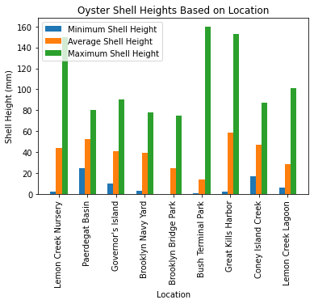
Code
# getting graph values
bar_titles = []
shell_height_avg = []
shell_height_max = []
shell_height_min = []
for site in set(df["Site"]): # looping through each site
site_df = df.loc[df["Site"]==site]
bar_titles.append(site) # adds the current site to the list of sites (for labeling)
shell_height_avg.append(np.mean(site_df["shell_height_mm"])) # adds mean
shell_height_max.append(max(site_df["shell_height_mm"])) # adds maximum
shell_height_min.append(min(site_df["shell_height_mm"])) # adds minimum
# plotting graph values
bar_idx = np.array(range(len(bar_titles)))
plt.bar(bar_idx-0.2, shell_height_min, width=0.2, label="Minimum Shell Height") # min
plt.bar(bar_idx, shell_height_avg, width=0.2, label="Average Shell Height") # mean
plt.bar(bar_idx+0.2, shell_height_max, width=0.2, label="Maximum Shell Height") # max
plt.xticks(bar_idx, bar_titles, rotation=90)
plt.legend()
plt.xlabel("Location")
plt.ylabel("Shell Height (mm)")
plt.title("Oyster Shell Heights Based on Location")
plt.show()

Slide 8
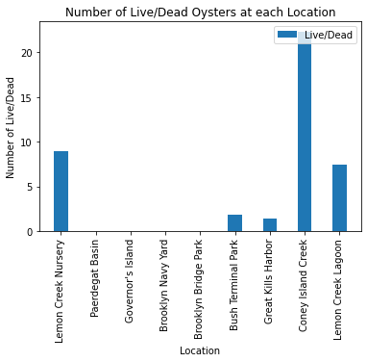
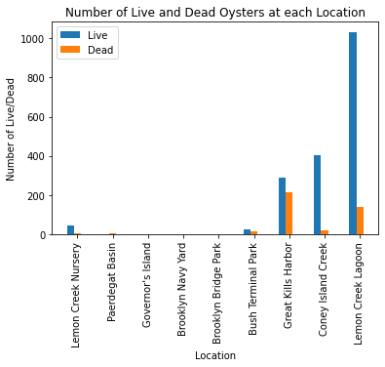
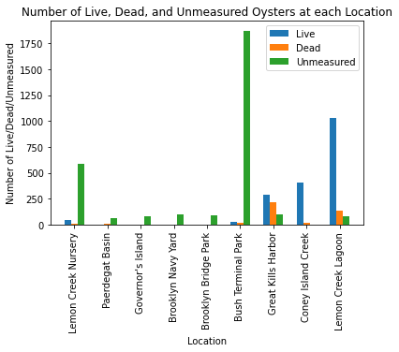
Which location is the best? (Part 1)

Slide 9
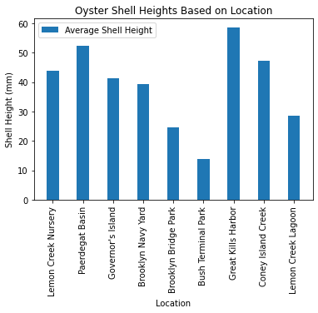
Which location is the best? (Part 2)
Notes:
Because we were missing data in the live/dead ratios we decided that the average oyster shell height would be a better factor to choose the best location
Great Kills Harbor
Paerdegat Basin
Coney Island
Last
Bush Terminal Park
Brooklyn Bridge Park
Lemon Creek Lagoon

Slide 10
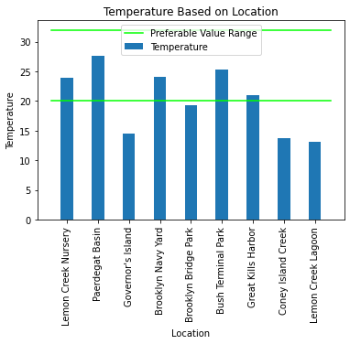
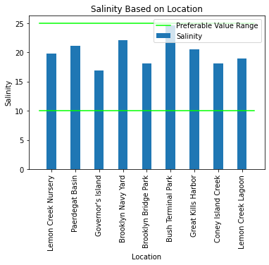
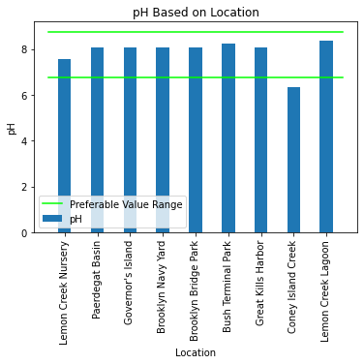
What location is the best? (Part 3)
Notes:
Here we have graphed three qualities of water that affect oyster growth, meaning temperature, salinity, and pH
Knowing the preferable water conditions for an oyster we plotted this to see whether each location lies within that range

Slide 11
Conclusions
Great Kills Harbor is the preferable location for oysters growth
Highest average shell height
Best ratio of max. to min.
Supports another range of factors essential to oysters
Notes:
From this data we can draw two main conclusions
The first is that the Greek Kills Harbor is the preferable location for oyster growth
It has the highest recorded average shell height
And it has the largest ratio of maximum to minimum compared to other locations
The second conclusion we can draw is that the Harbor is in compliance with other factors essential to an oyster’s growth,
Regarding things like pH, salinity, and temperature

Slide 12
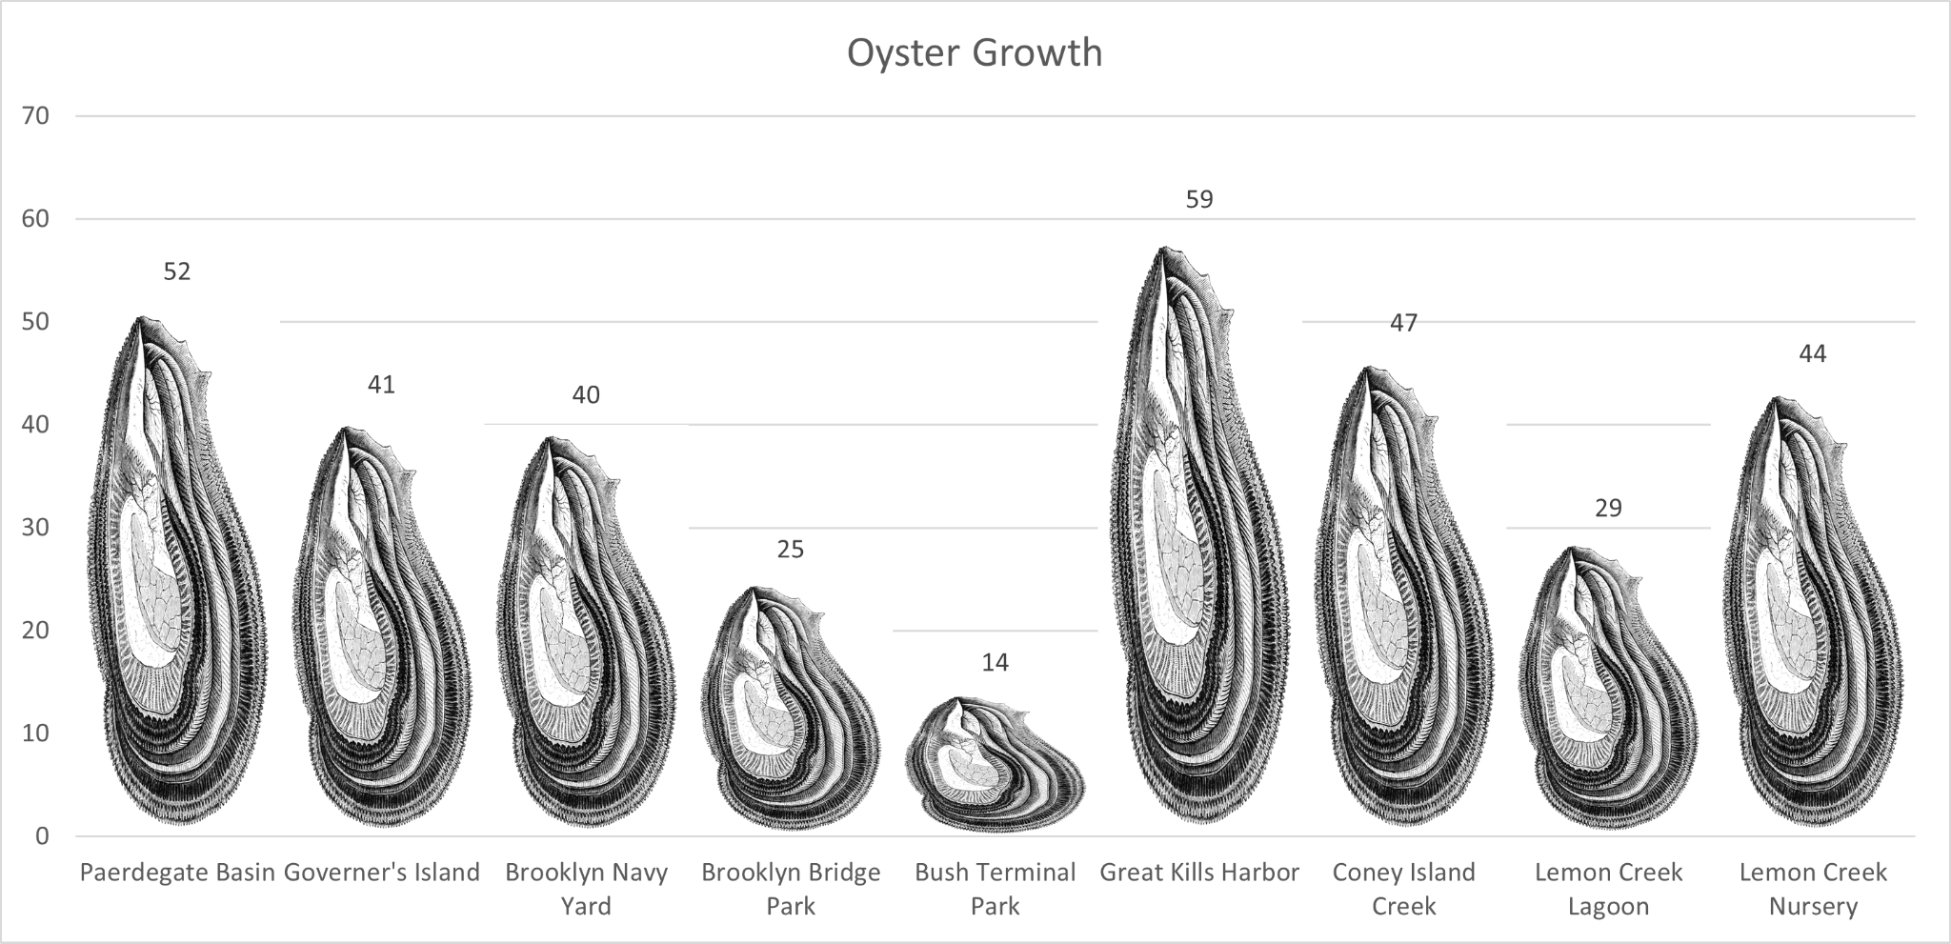
Telling a Story With Visualization
Notes:
To help better understand the data we came up with two visualizations
On this graph we can see an oyster is plotted for each location, and they are scaled to their average shell height
For example the average oyster in __ is __ millimeters tall

Slide 13
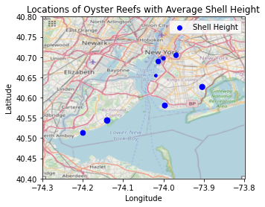
Where are the oysters located?
Notes:
Within the data we were also given the latitude and longitude of each location, so by plotting each spot we can better understand the geography of the region

Slide 14
Sources
Billion Oyster Project
Scientist: Anna Fraioli; Data Curriculum Specialist
Appfigures - ASO tools, App Intelligence, and Analytics
Provided Information (Github)

Slide 15
About our Experience
Gabrielle: “From Appfigures, I grasped a different perspective on starting your own company, the mentors were very supportive and not only did I learn about python but also about which skills I could use in a specific workplace.”
Alexa: “It was a interesting and valuable experience which helped me understand more about STEM and the BOP.”
Alan: “The mentors and those that shared their knowledge with the STEM students made this enriching experience possible. ”
Arnav: “It would have been very hard to understand the concepts taught in the STEM Institute, if not for the diligence and hard work of our mentors.”
Julia: “I am thankful for the experience that the STEM Institute provided me, as well as the amazing people I got to meet.”
Matthew: “This was challenging for me but I learned a lot more about what is STEM and how you can use these skills in different work environments. I also liked the science presentations and the chance to meet new people.”

Slide 16
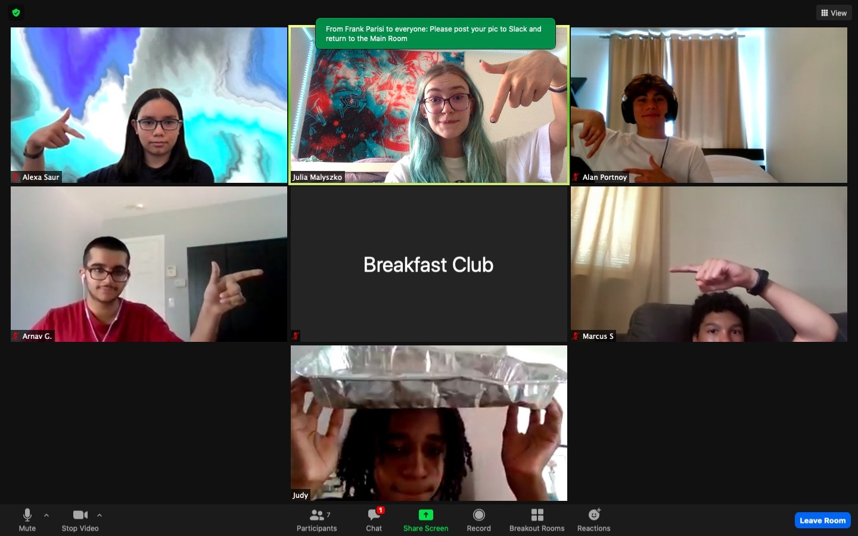
The Team

Slide 17
THANK YOU
Any Questions?

